Slide 1


TEAM CHARTER:
Vijay Kumar Reddy Jetty (1992711)
Venkat Reddy Mallesh (1993122)
Dinesh Avula (1992713)
Saiteja Yatam (1993100)
Srikanth Reddy Marakkagari (1993120)
Navya Manda (1894204)
Kalyan Teja Danda (1993115)
Apartment Finding
Project Coordinator:
Pargol Poshtareh
Project Guide:
Sakkaravarthi Ramanathan
Richard Grand'Maison

Slide 2
Introduction:
The Apartment Finding mobile application had a user interface that will allow their customers to view the properties, descriptions, and cost of different properties available. The user had the ability to register and login to the Android App and book their desired property. The Android App will be responsive, allowing for the customer to view it on any device, from tablets to cell phones. The landlord will also be able to login through the same Platform but had the ability to add/remove new properties, change cost of property etc., admin to verify properties and guest user to view properties for any future purpose.
User can reset his password by providing recovery email and can change his email and password if required. Can add profile picture and can filter the property posts by selecting the price range, user can add his favorite property posts to the favorites.

Slide 3
Functional Requirements:
1)Sign Up:
User need to create an account by selecting a unique and a valid password. It is mandatory for the user to make an account otherwise the user will not be able to login to the application.
2)Login:
User can login to the application by entering username and a valid password. It is mandatory for the user to login to the application otherwise the user will not be able to post/book property.
3)Search:
User can search different kinds of categories in the search bar. After searching a category, all the related property posts of that category will be shown on the screen.

Slide 4
Functional Requirements:
4)Post a Property:
User must fill the information about the property to rent out, such as title, description, category, price, image, email so that they can post a property.
5)Communication:
Tenant can contact the Landlord, vice-versa, through chat.
6)Filter:
User can filter the properties based on different categories. The application will filter all the properties based on the selected category and will display the properties to the user. 7)Favorites:
User can make desired properties as favorite and he can directly access those properties from favorites and user can also delete properties from the favorites.

Slide 5
Functional Requirements:
8)Edit Profile:
User can make changes to his profile such as changing password, email and profile picture.
9)Edit Post:
User can modify his property post for updating the information, such as the user description to make any changes in the specifications of the property. 10)Delete Post:
User could delete the uploaded property posts if the property got rent out.
11)Logout:
User can logout the application by clicking logout button.

Slide 6
Non-Functional Requirements:
The advertisements shall take initial load time to display, depending on internet connection strength.
Accessibility to next page and to refresh the page must be done corresponding to set timer.
Platform to run the app must be Android.
The application should only allow the authorised users to get access to verify/deny the property posts.
An interface must be easy to use from the first time the user interacts with it. The user must be able to understand how the application works.
Key tasks should be made as efficient as possible. It refers to the fact that how the application performs various tasks.
English is used for first version later depends upon requirement.

Slide 7
Determination of features to include and exclude:
Including and Excluding features depend on various factors such as user experience, client requirement, technology, cost etc. Here, we had gone mostly with user experience which makes understandable to any.
Type | Inclusion | Exclusion
View | Recycler view is advanced form of list and grid view. It has more features compared to counterparts and they can make viable for users. | List and Grid view is not compatible because want to show a lot of items, and the number of them is dynamic.
Communication | Chat will be better option for users to respond with freedom of time. | Call may not work all the time with busy users.
Search Properties | Filter to get desired properties gives exact results to find suitable properties. | Recommendations for similar properties may not give clear results.
Save Properties | Favorites is a interesting name and had a great looking feature to save likable properties. | Bookmark also got similar function but a old name to include.

Slide 8
Decision making in Technology:
Technology decision is made under an environment which is a mixture of certainty, uncertainty, risk and pressure. Our project involves set of players. Evidently, will opt technology which most set familiar with. All of us are familiar with android studio(java)&xml, we didn’t make a move to change it. Only question rises with database, which database works better for our app? MySQL vs Firebase: MySQL is rdbms while firebase is schema less NoSQL database. Disadvantages of Firebase Real Time DB:
it is NoSQL database with a lot of restrictions
you will need to pay for the services when your app grows (and it will happen far earlier than a million of users. Our experience shows that even with 10 users per day you can reach the free plan limits)
it is hard to build some DB statistics (a simple request "how much orders users create per day”, for example, can be a developer's headache)
it is impossible to do a search by several fields (for example you will have problems with building a filter by several fields like price, weight, and size for one search)
Evaluating the “right choice” for any given component is completely a matter of understanding the requirements of your app, evaluating your options, and choosing the one that best suits its needs. Firebase and MySQL are completely different choices and it’s not a simple matter of figuring out which one is “better”, however you might define based on the longer-term vision of the project.

Slide 9
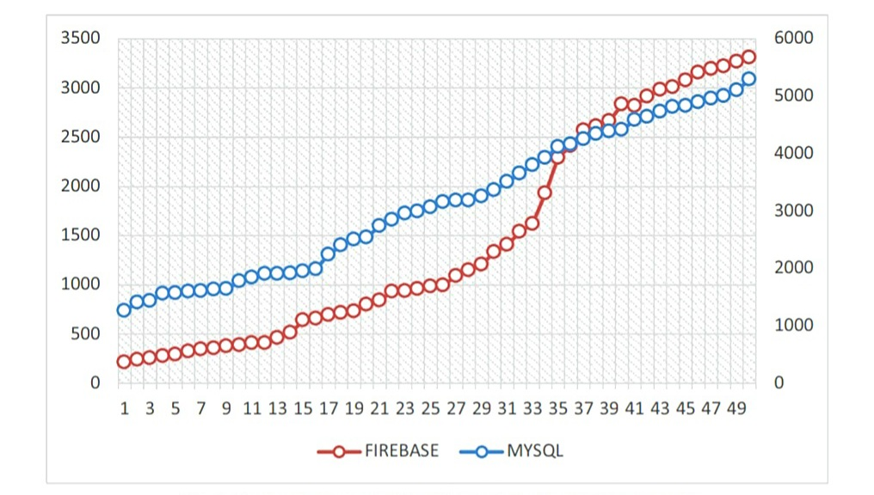
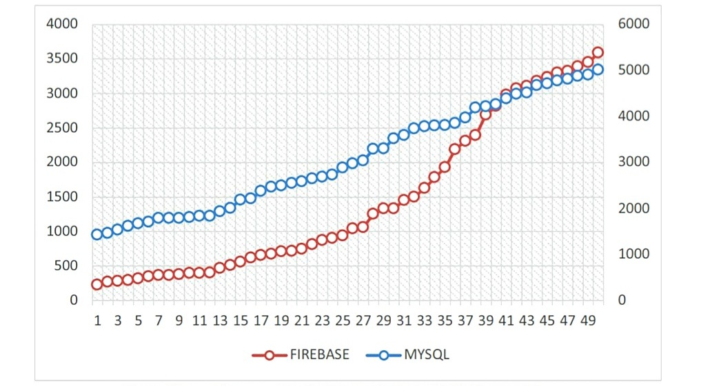
MySQL vs Firebase:
Based on the Wilcoxon signal rank test of the comparison between Firebase and MySQL, it can conclude that MySQL is better for our apartment finding app. Here are graphs for update and delete operations, X-axis shows number of experiments and Y-axis shows response time in milliseconds.
Mean performance time in milliseconds for the UPDATE operation
Mean performance time in milliseconds for the DELETE operation
Source:- www.sciencedirect.com

Slide 10

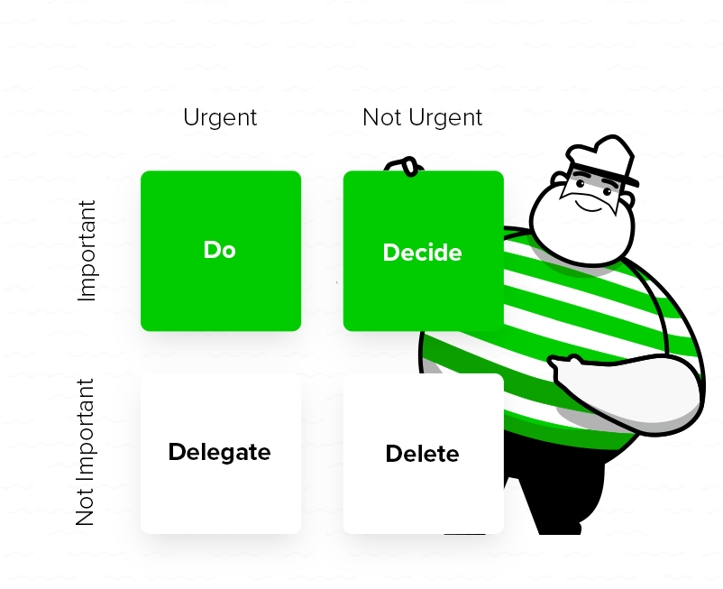
Work Management:
Selected task will be divided into parts with respect to skills of individuals, Deadline will be fixed.
Set up task
Summarize each day with fellow individuals through medium of communication
Shorter deadline for individual
After shorter deadline, individual can help others if his/her task got finished or can seek help from another.
Work-Priority matrix for task
Push finished work/output to git, Repeat the same for any given task.

Slide 11
Division of work:
Name- Vijay Kumar Reddy Jetty
Java- login, splash, image, main, message activity and fixed bugs.
XML- chat, image upload.
Php- tenantfav, tenantrequests, search, searchviewpropertylist
Updated documentation.
Name- Dinesh Avula
Java- login, fav list, filters.
XML- image upload, fav list, filters.
Php- reply, myrequests, landlordviewproperties, landlordlogin.
Updated documentation.
Name- Navya manda
Java- all admin properties, login page activity, image upload, landlord dashboard, main & message activity.
XML- chat, image upload
Php- get chat, get photos
Updated documentation.
Name- Venkat Reddy Mallesh
Java code and xml- Registration, Splash screen bug solved, chat.
Php- booking, admin login, property code, add photos and fav list.
Worked on connecting the code to the database using the apiservice and retro client, Updated documentation.

Slide 12
Name- Kalyan Teja Danda Java- search properties, request activity for tenant Xml- search property, Chat Php- properties, profile, price, photos And worked on fixing errors Updated documentation.
Name- Srikanth Reddy Marakkagari Java- Deleting properties, get properties, search property filters, landlord edit profile, landlord activity
XML- booking, landlord profile, landlord message, image upload
Php- fav list ,error log, log file
Updated project report&php files Changes
Name- Yatam Saiteja
Java- chat code, Fav list, Main activity, slider view
XML- slider view, property screen, edit profile, edit my properties
Php- delete property, configuration php, get chat, get photos
Updated documentation
Couple of changes made in the code when fixing the bugs
Fixing the activities order

Slide 13


Working Remotely:
Initially, We thought it will be stressful to work from home. Accordingly, We set up wonderful working environment and produced individual shorter deadlines to help each other. Eventually, thinking back, there have unquestionably been a few knocks on my far-off excursion, yet the general experience has been positive. I don't expect I'll return to customary in-office business any time soon.
Impact of COVID-19:
COVID-19 hit hard globally and to admit it is stressful for any individual. We lost greater devices and high-speed internet from college and totally with our own devices which are not capable to work longer. It is difficult to meet our teammates with lots of restrictions to know how the works goes and all. It was bitter experience with impact of covid-19.

Slide 14


Interesting and Challenging things in our application:
Filter:
Filter is challenging feature to build. Initially, We built manual search box to find properties. On recommendations from our guide we developed filter, it is a bit time taking task to build. Luckily, at first we opt SQL over Firebase on expecting these tasks, we had written queries well and made good working feature.
Chat:
We have bug issues with chat functionality it was quite challenging to resolve. We build a dynamic chat which is a great thing for college project. Writing queries had been difficult than expected. Firebase would have helped a lot on real time chat.

Slide 15
Easiest feature built in our application:
We thought login and registration pages with different users like Tenant, Landlord, Admin and guest was challenging to design in a single page but after a proper thoughtful discussion and with little knowledge from internet on how different types of login that were created before, we learned how to design all of them in a single activity and it went lot easier than we have expected. We had opted to go with check box and by placing that we got a simple user experience to navigate to further pages in our application. Although we got a bug later in this page. We realize that we were missing out an if statement in our login java activity and fixed that bug by writing out a new if statement.
Overall, even with a little bug in between it is our easiest feature to build with rich user experience.

Slide 16
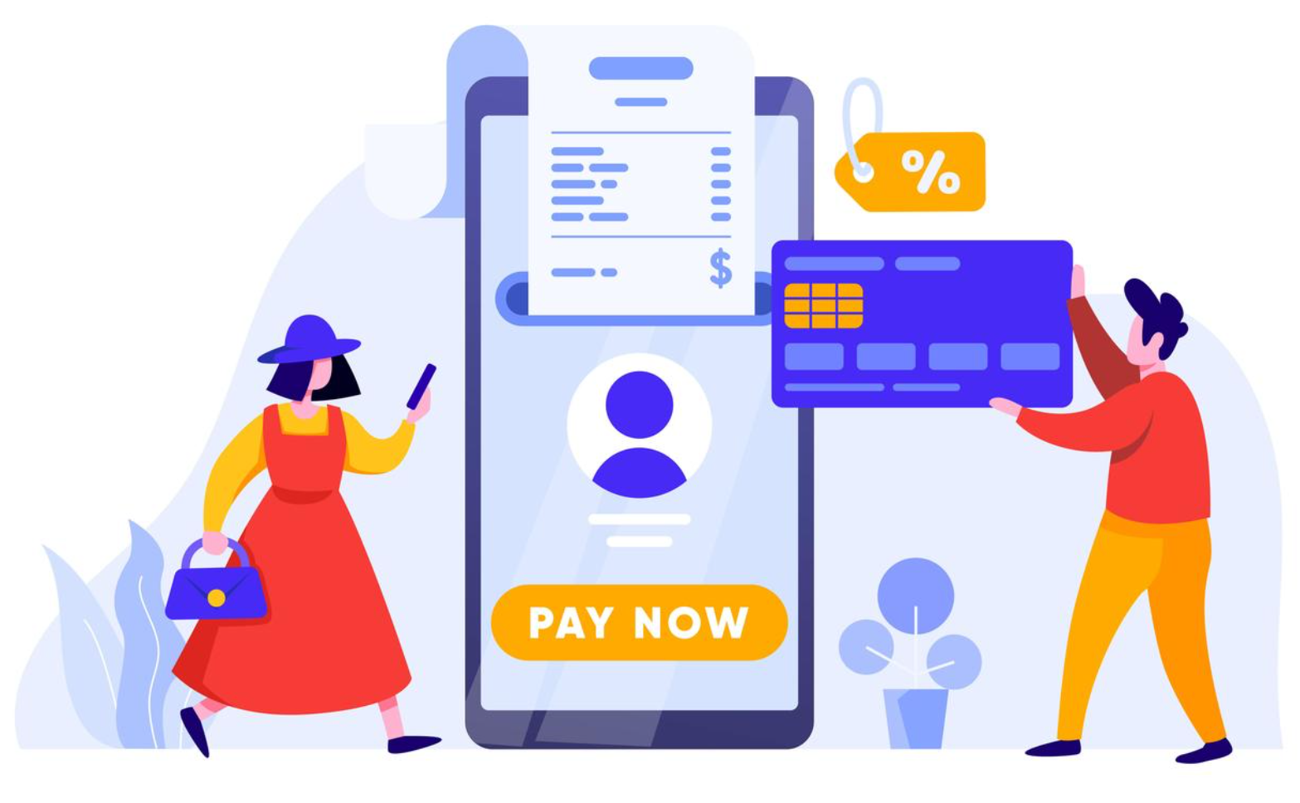
Decision to regret:
Without the proper research we have added payment to our user stories in the first sprint which was a mistake, these types of apps don’t build payment, if any given proper plan we are still thinking to add this feature in future because it helps to complete entire process of renting out an apartment and, we want to add more features and functionalities like maps so that it will be useful for the real time and this will be the future scope of our application.
Payment Feature

Slide 17
GitHub Usage Experience:
GitHub is an open-source repository hosting service, sort of like a cloud for code. Git simplifies the process of working with other people and makes it easy to collaborate on projects. So, Our group decided to work on several files and can easily merge their changes in with the master branch of the project.
Conflicts:
Our conflicts experience with git are perfectly solvable. We got some merge conflicts while sending pull requests, Since these are not complicated one’s it got resolved by resolve conflicts button. Haven’t experienced any major conflicts but learnt in that scenario, the resolution must be done locally first.

Slide 18
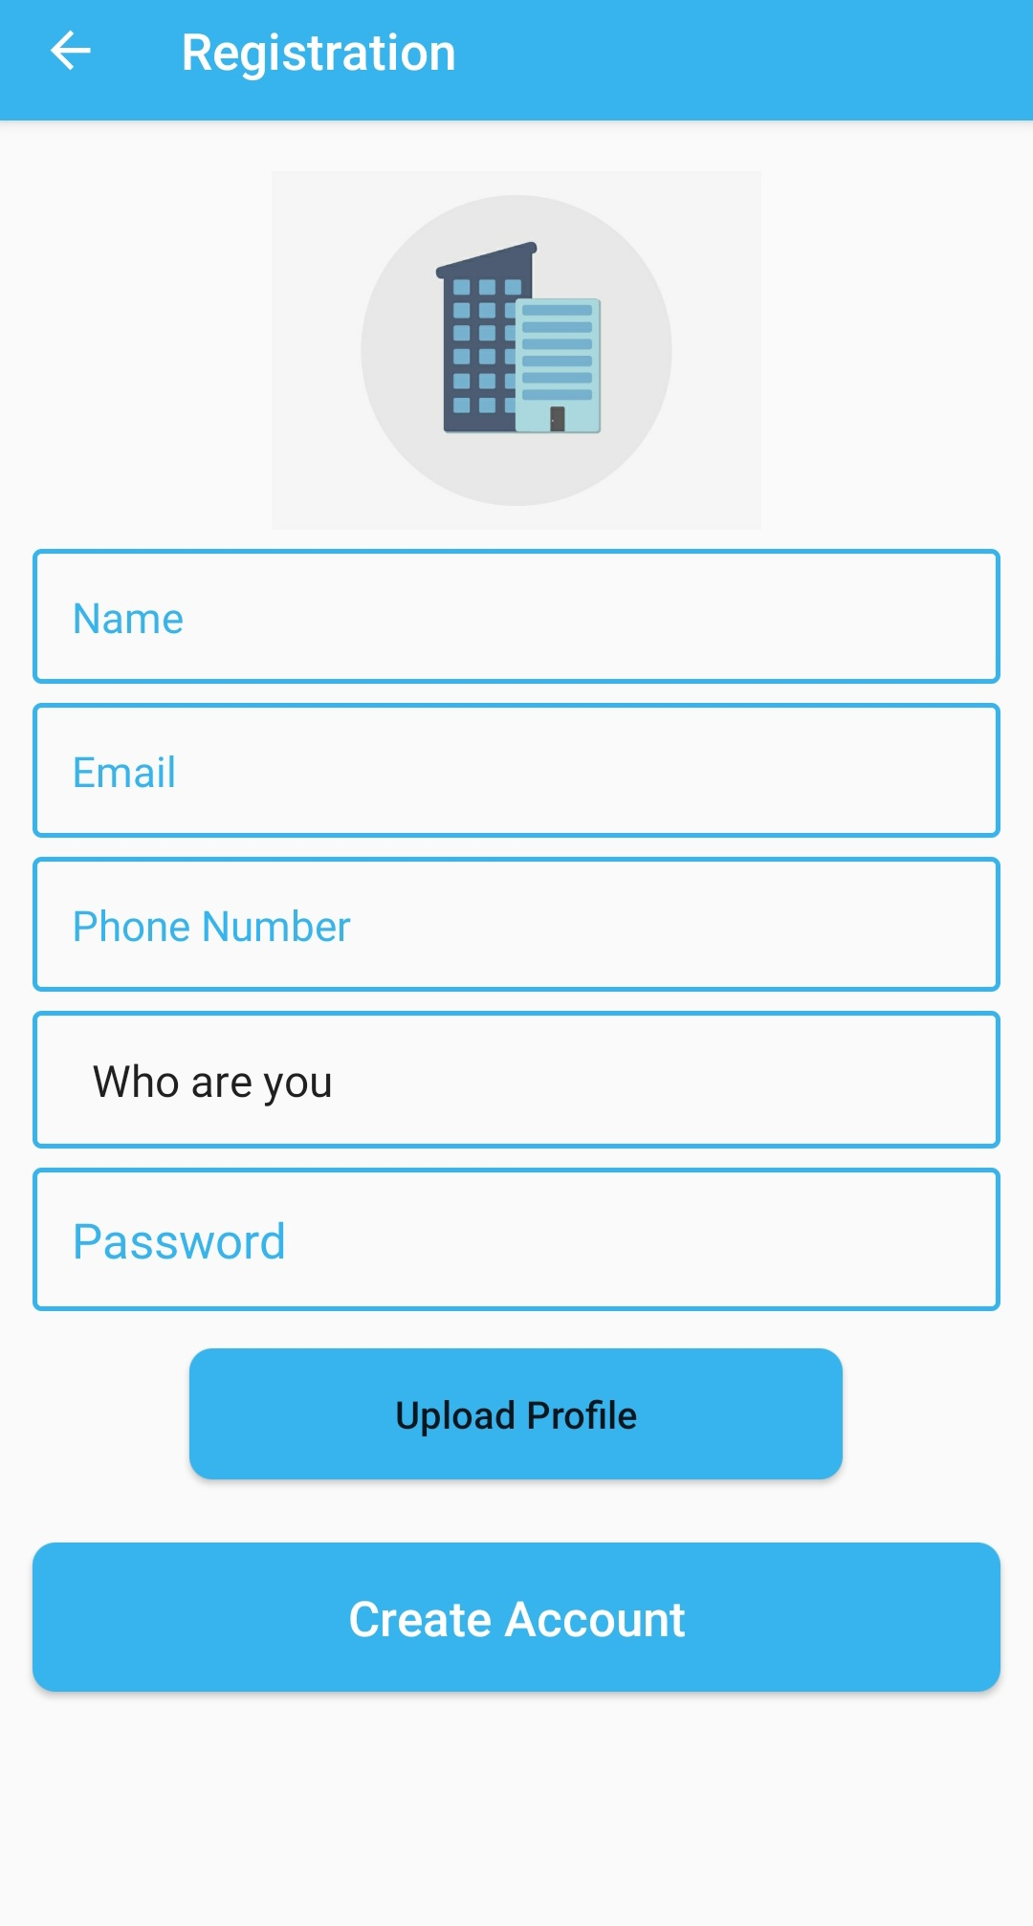
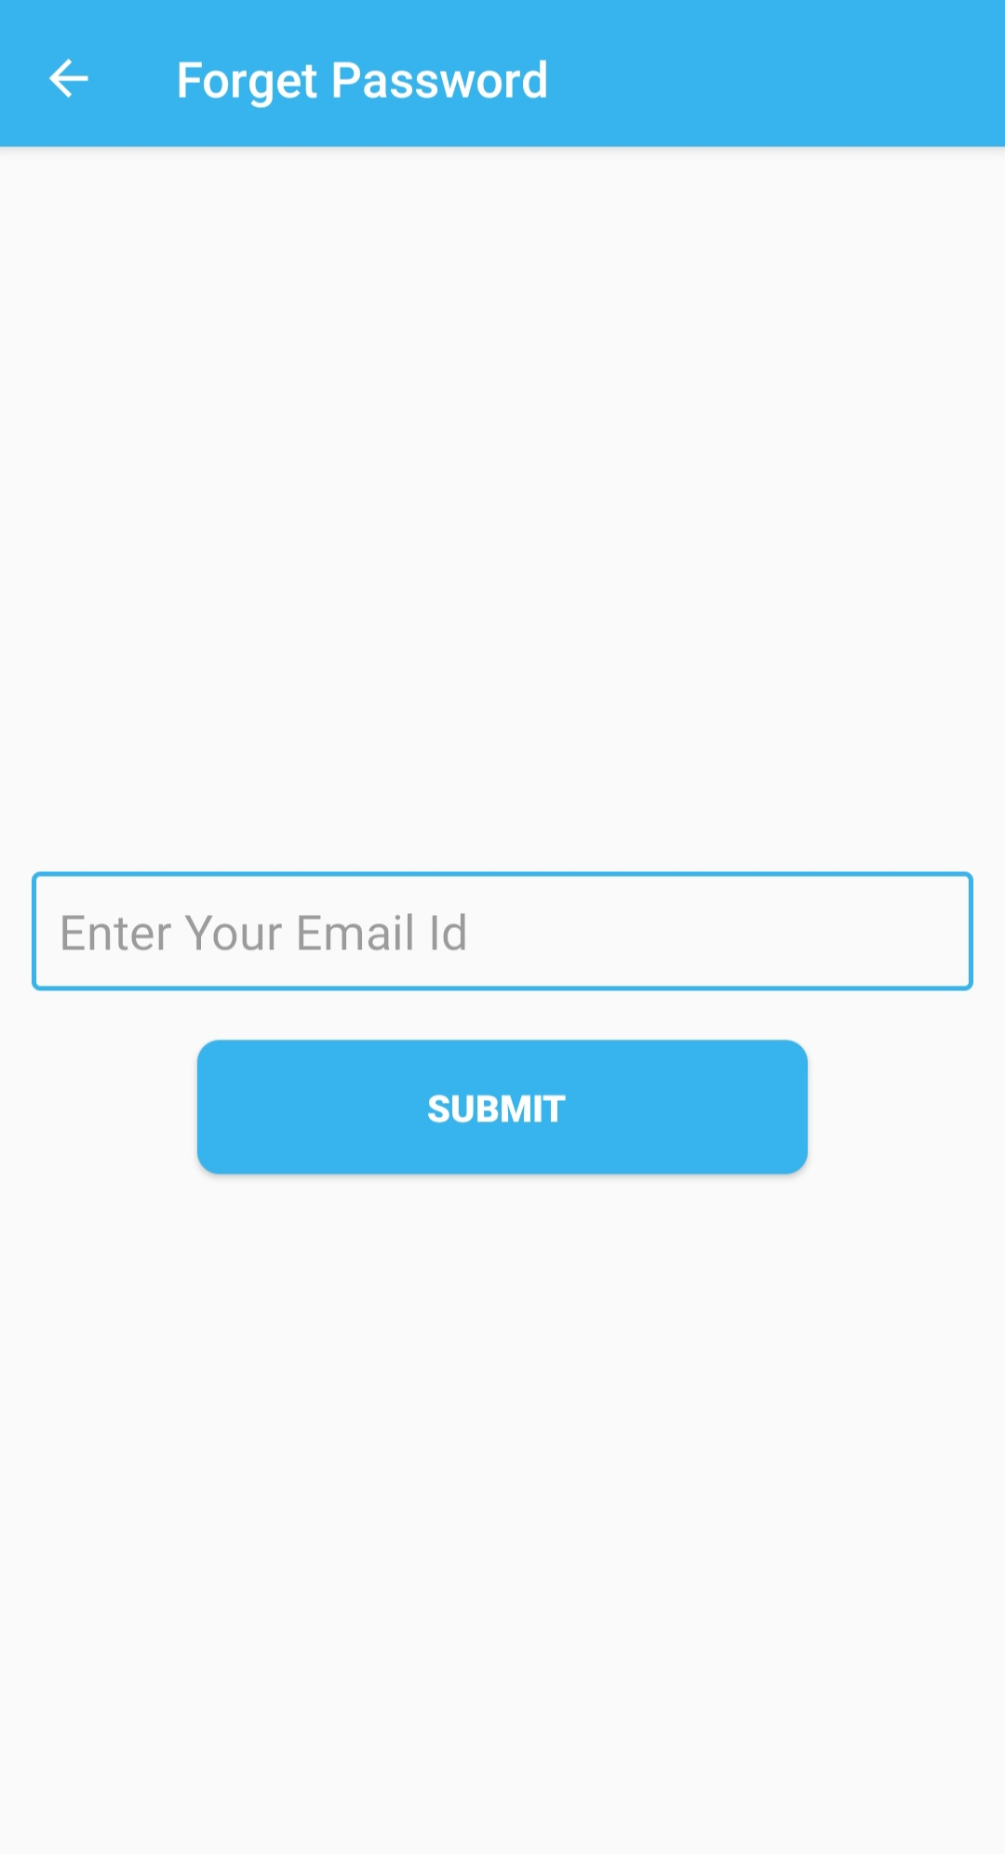
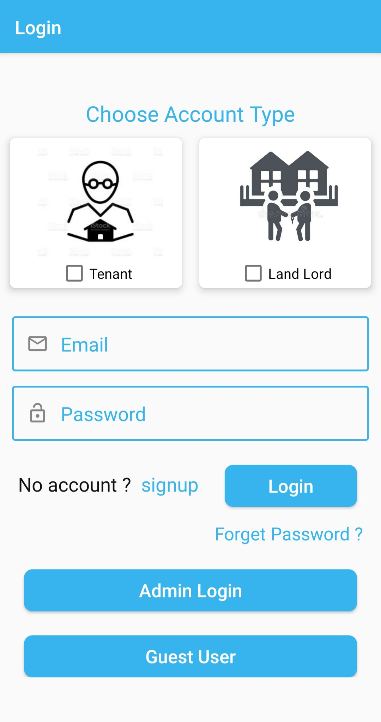
Working Screens:
Tenant:

Slide 19
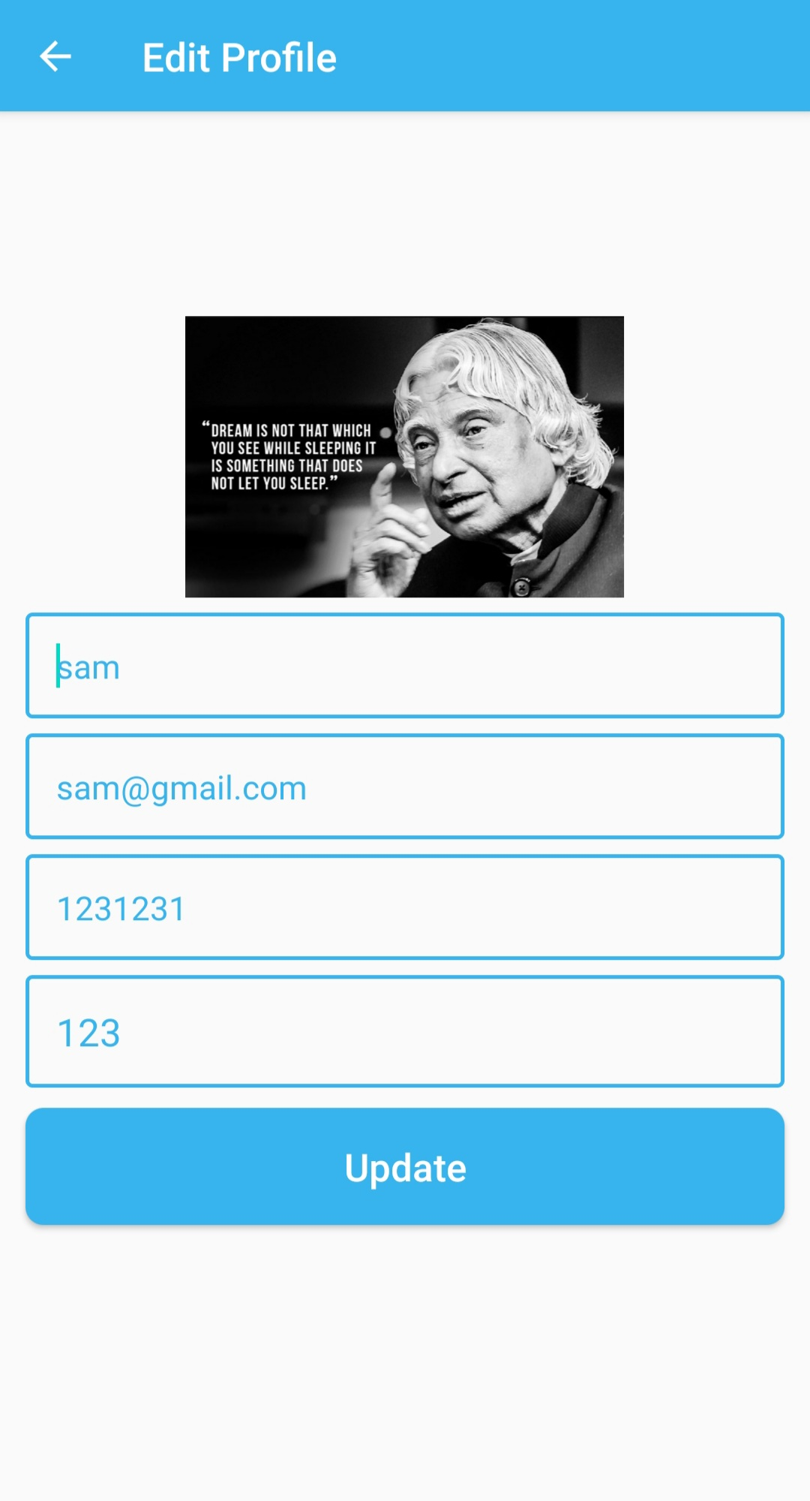
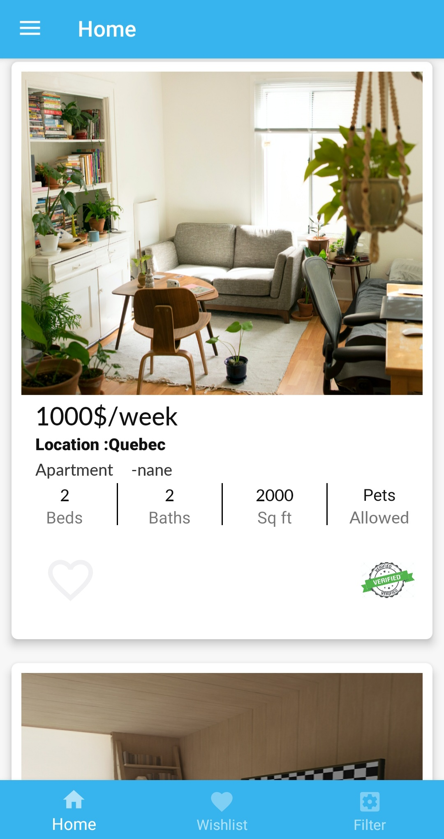
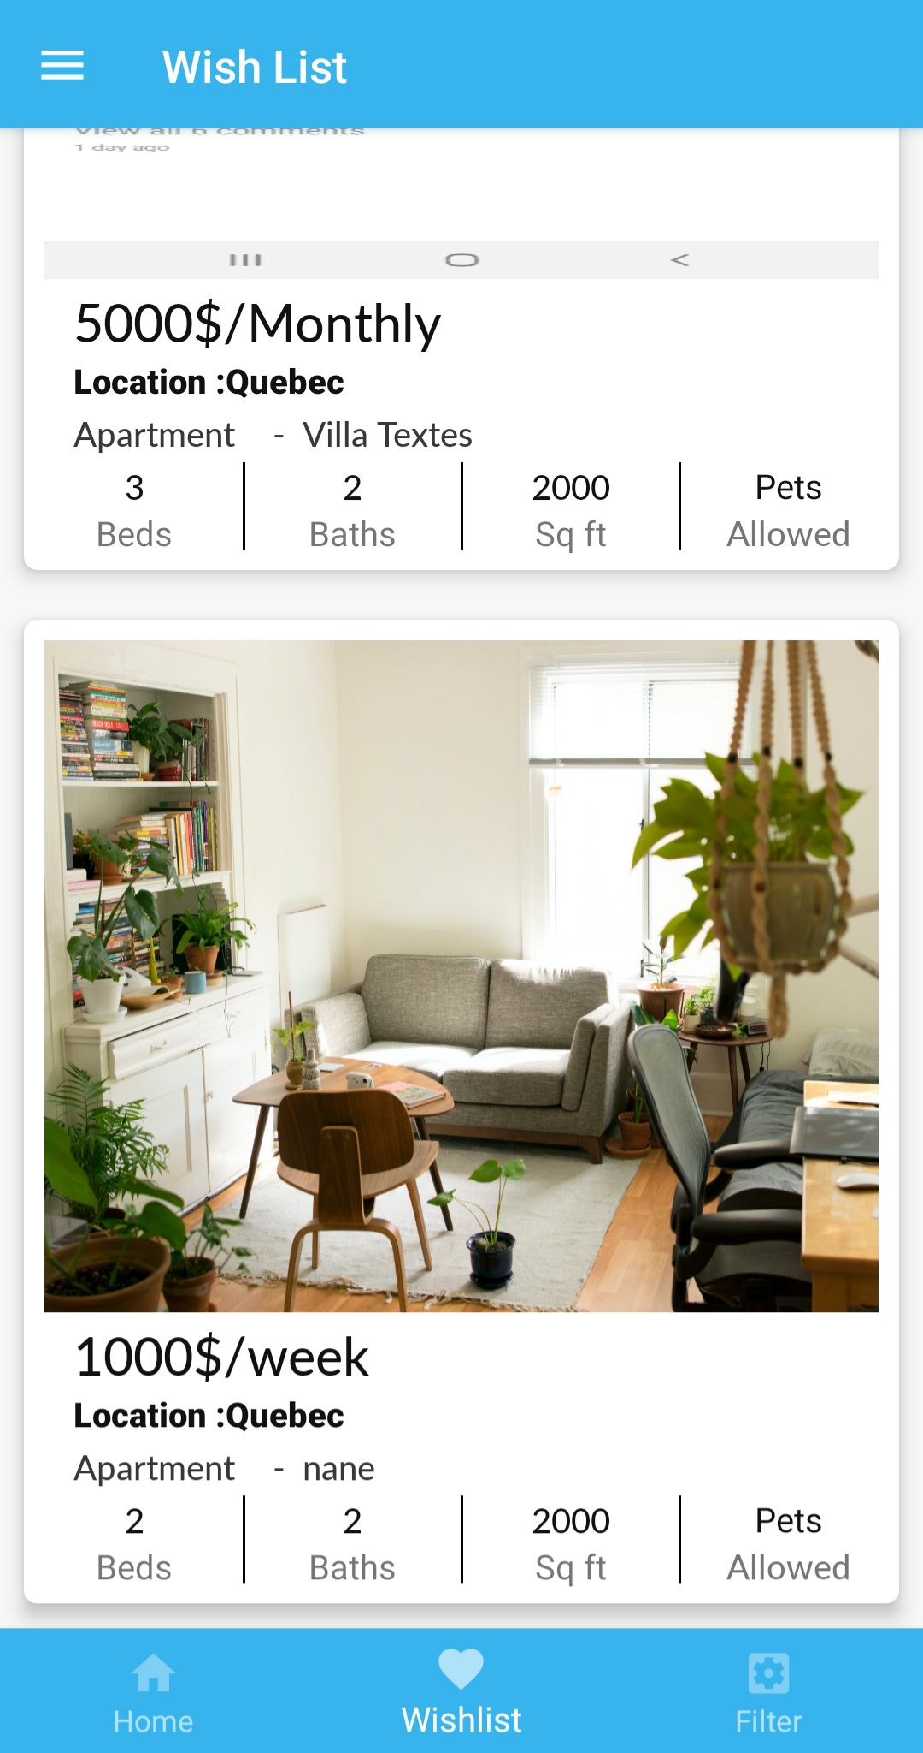
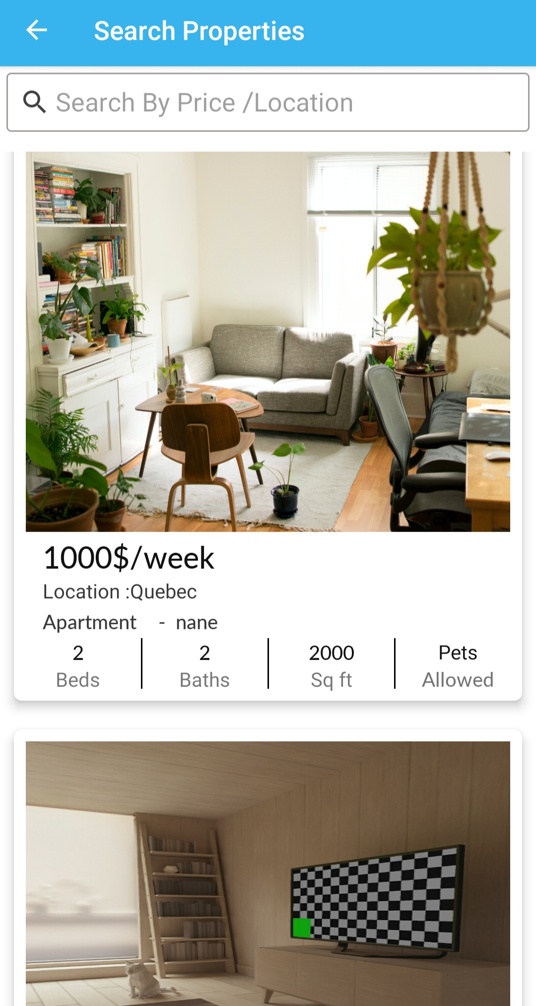

Slide 20
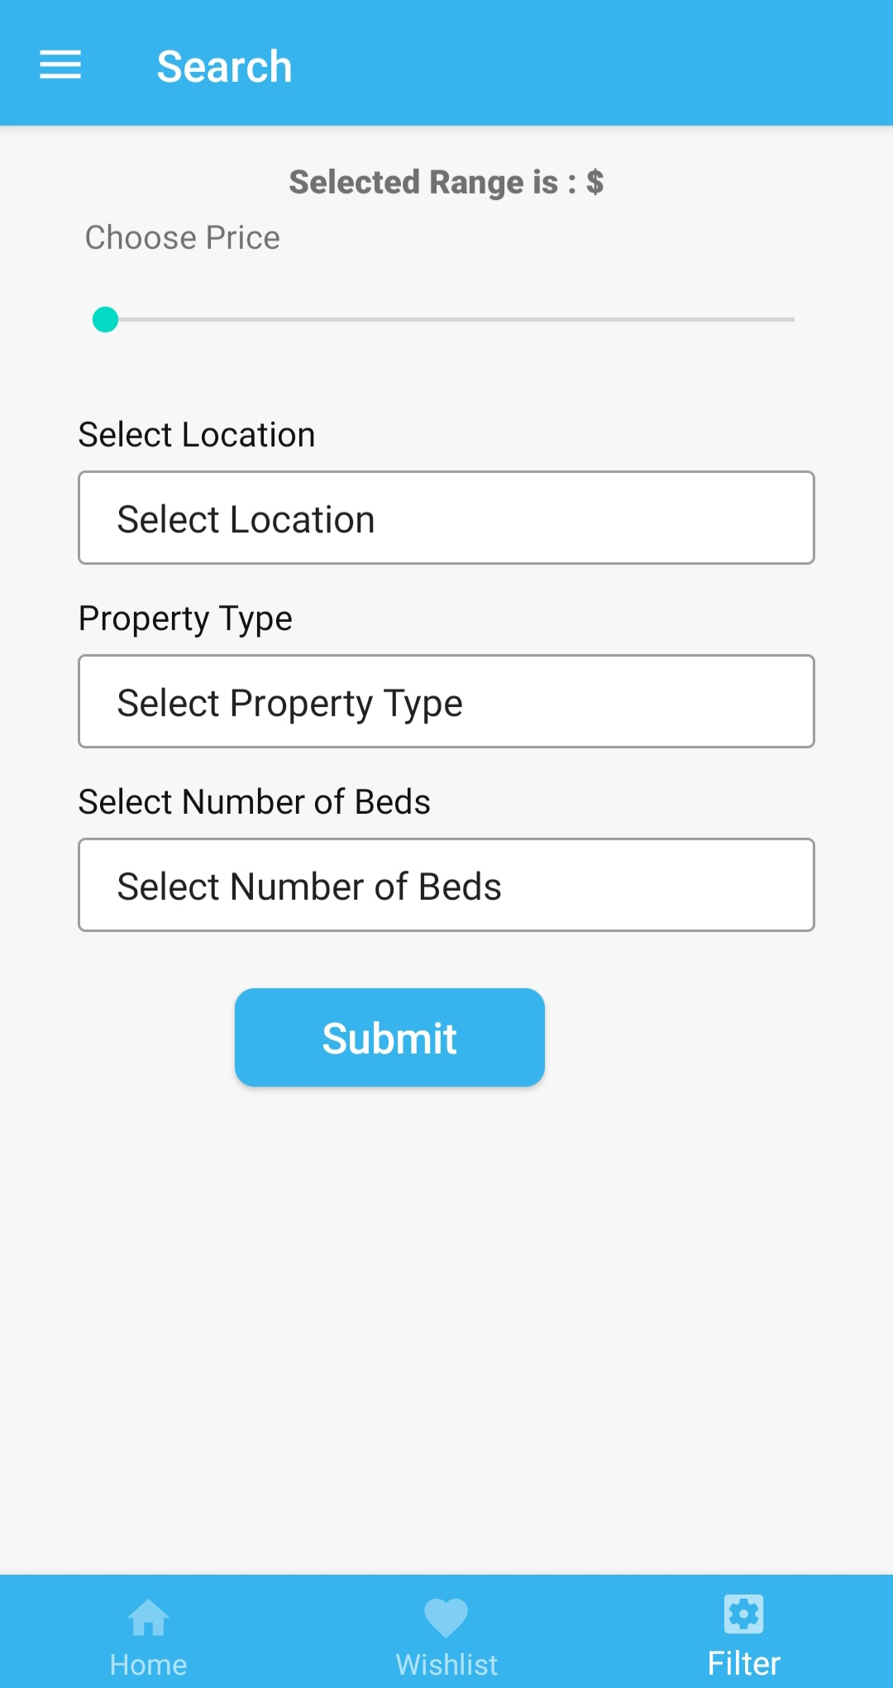
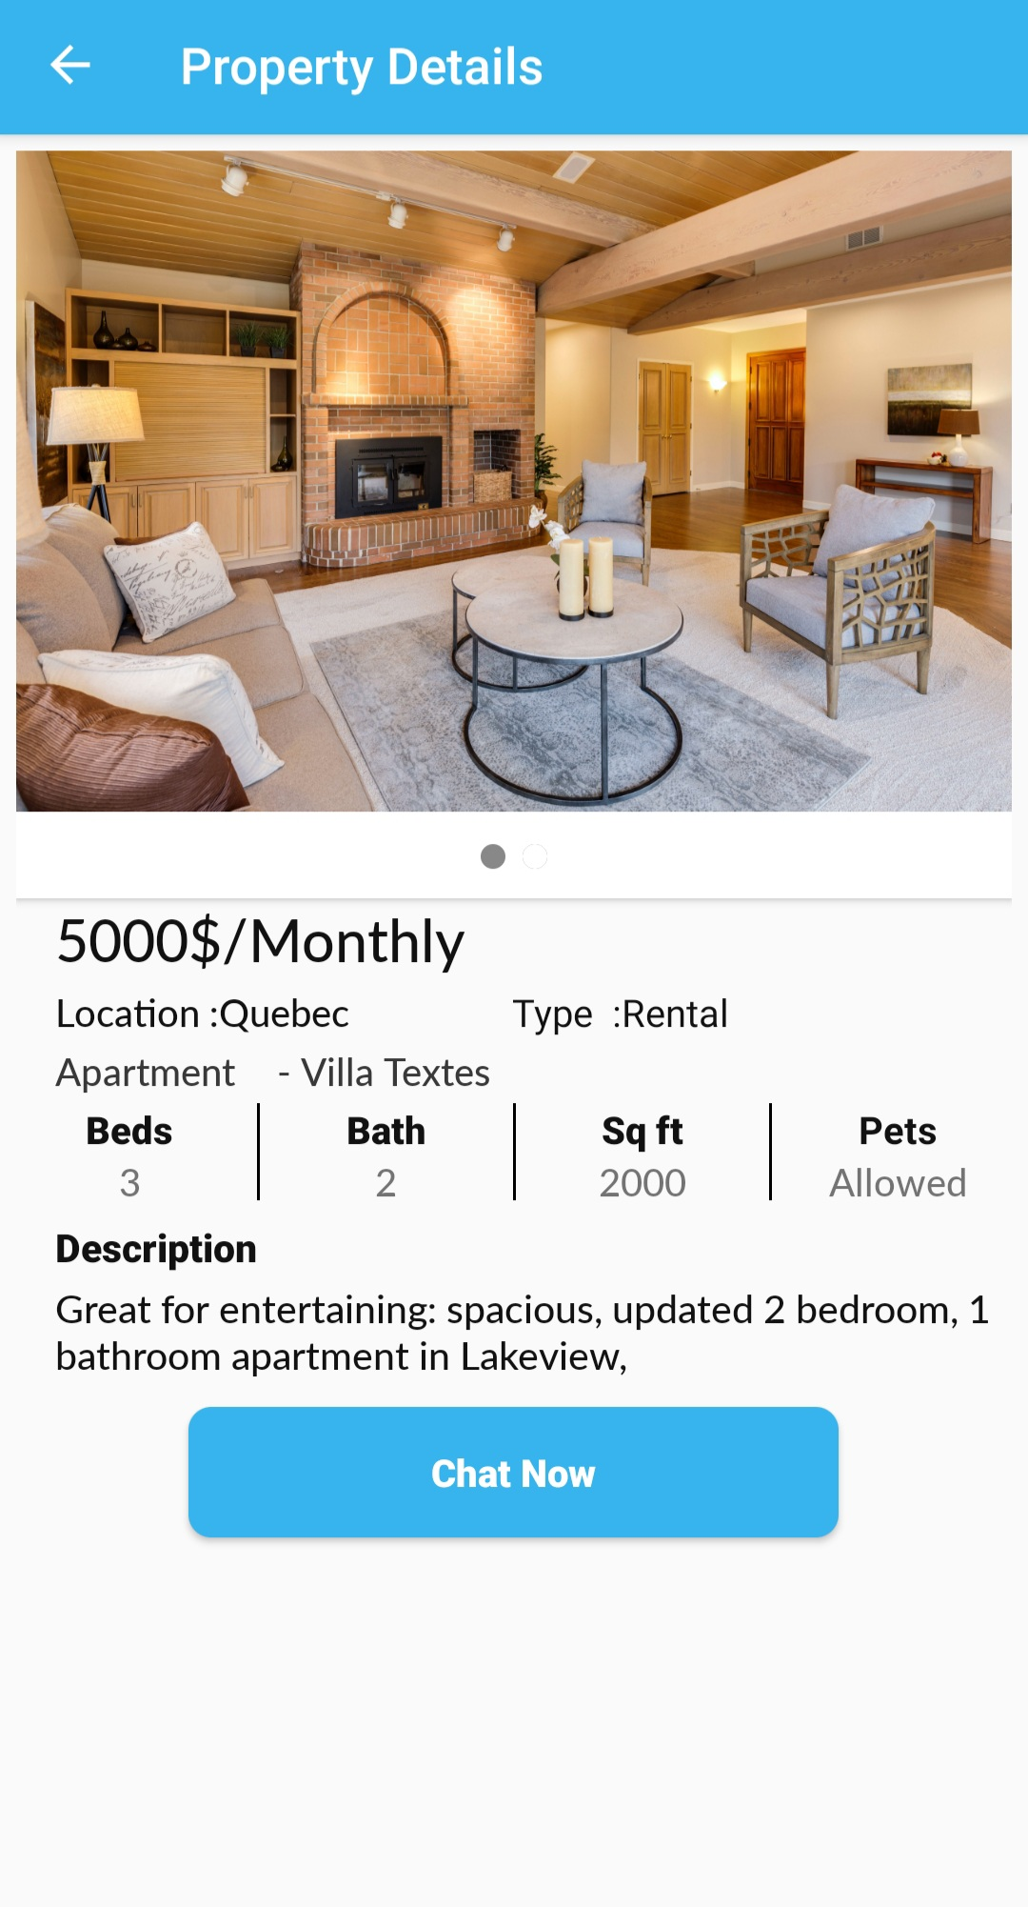
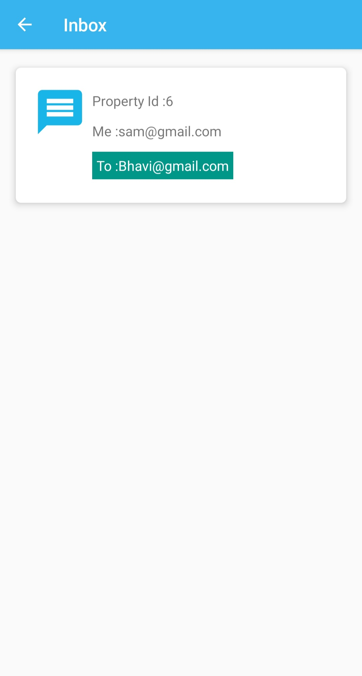
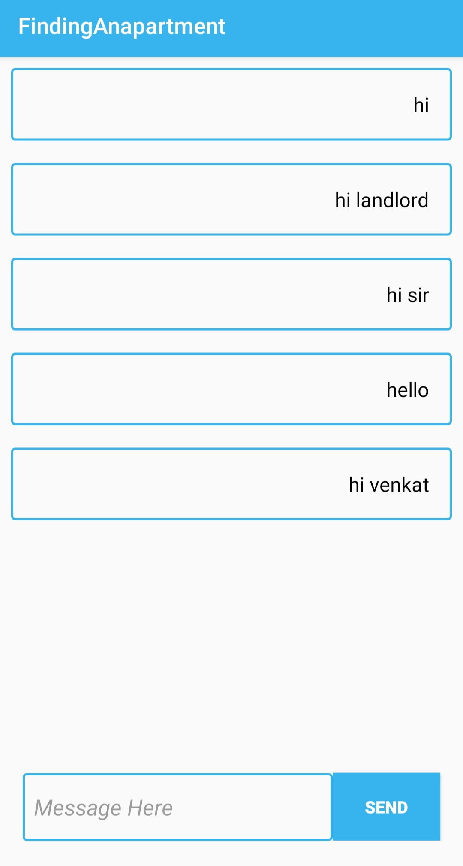

Slide 21
Landlord:

Slide 22
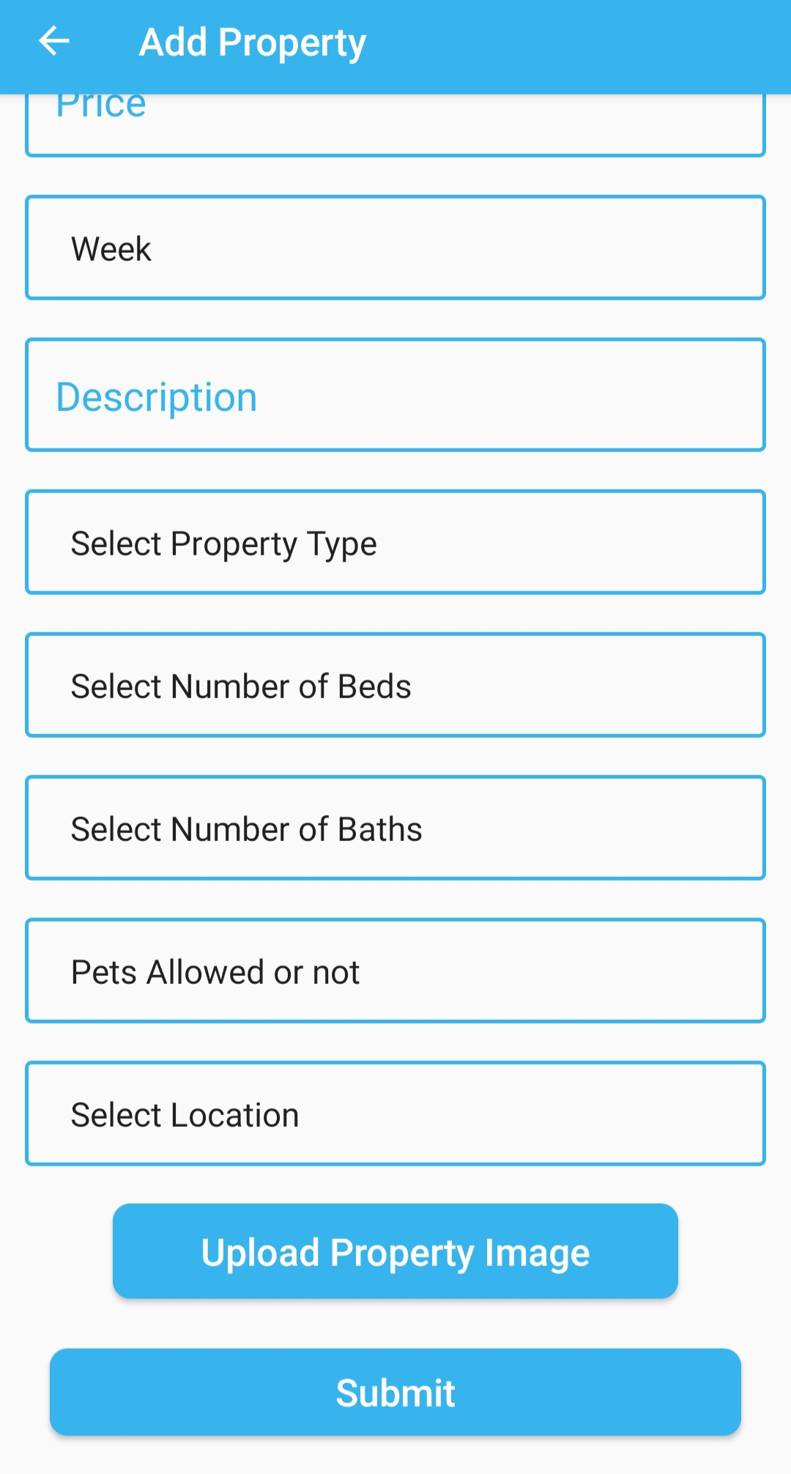
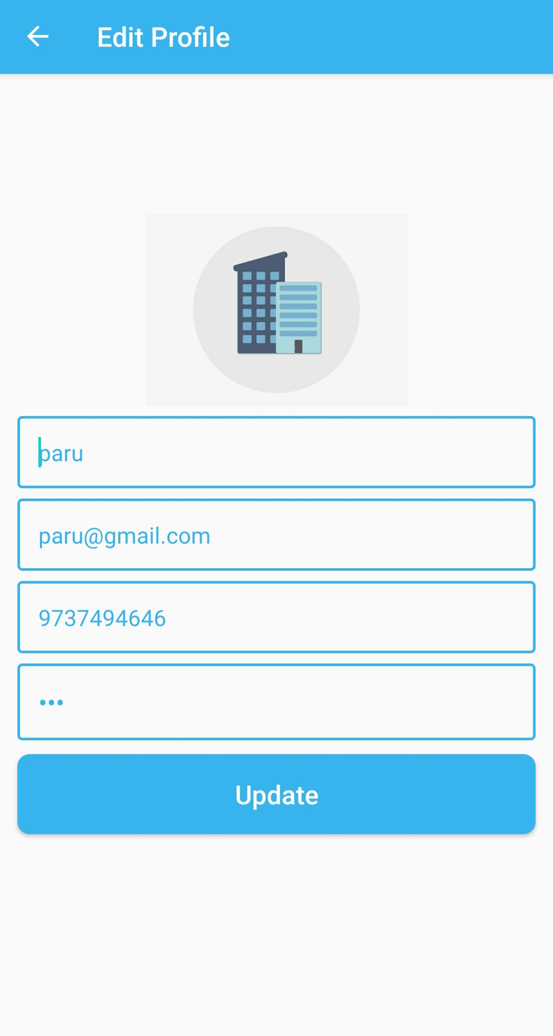
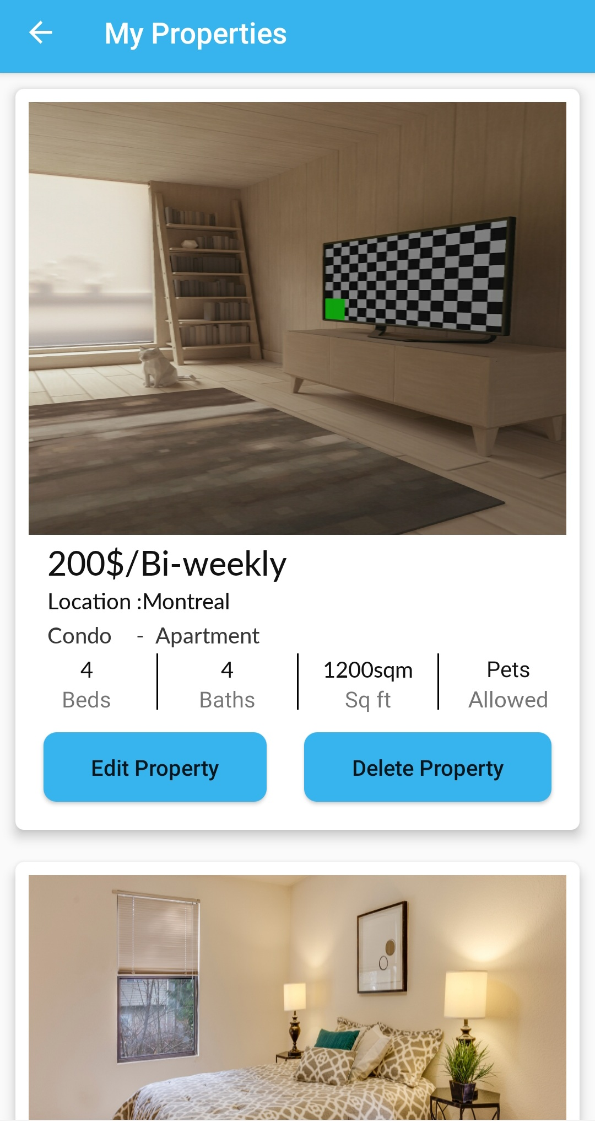
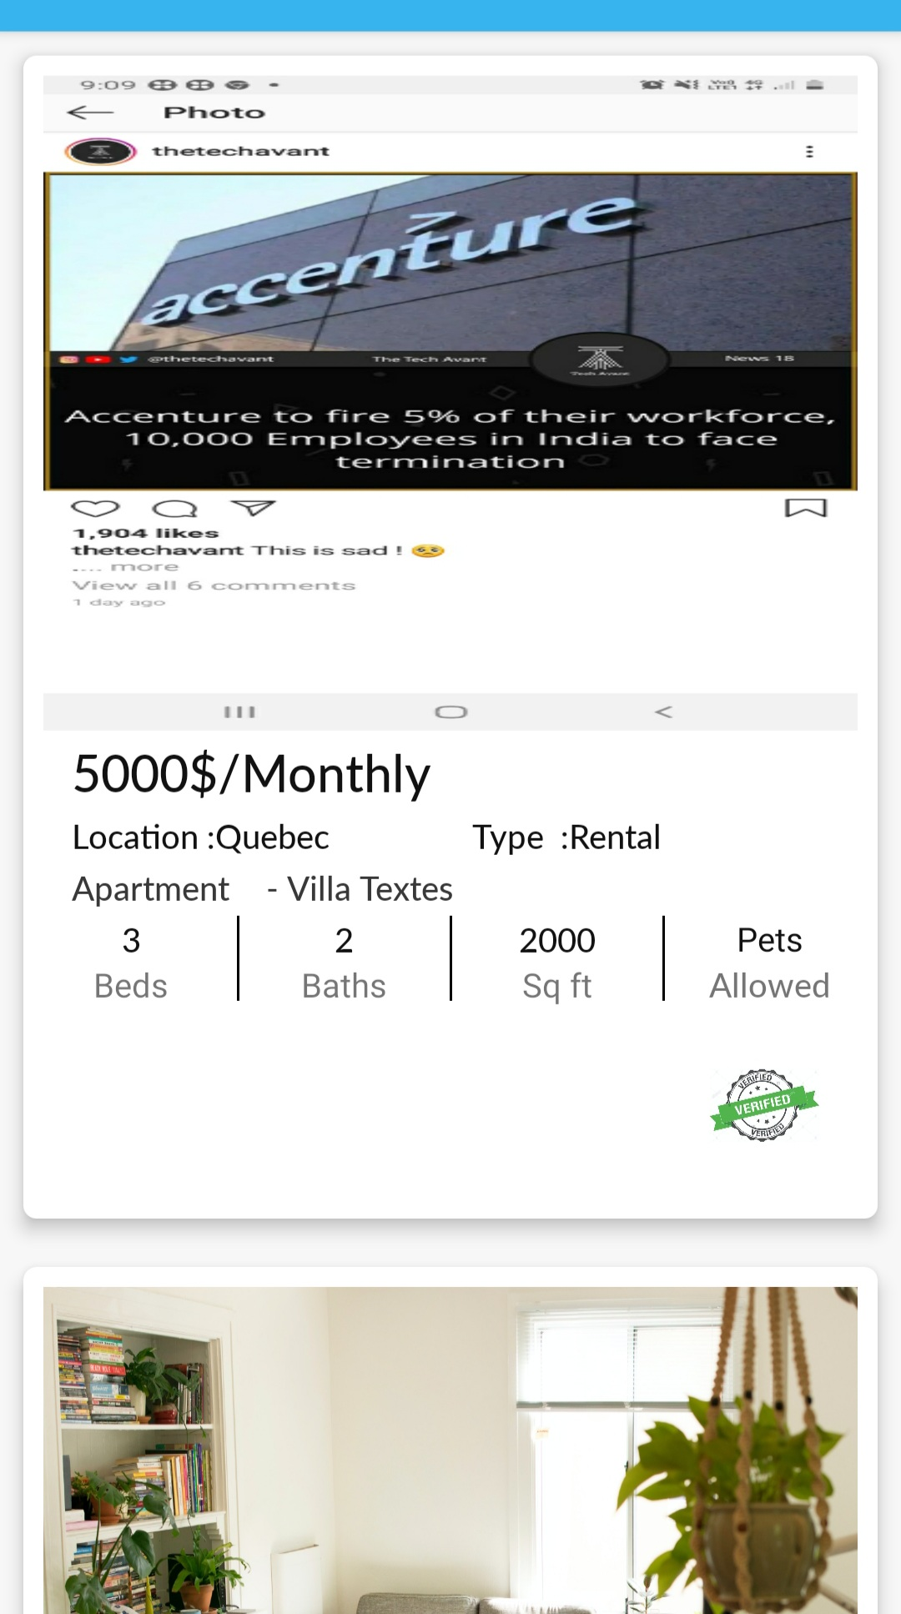
Landlord Home

Slide 23
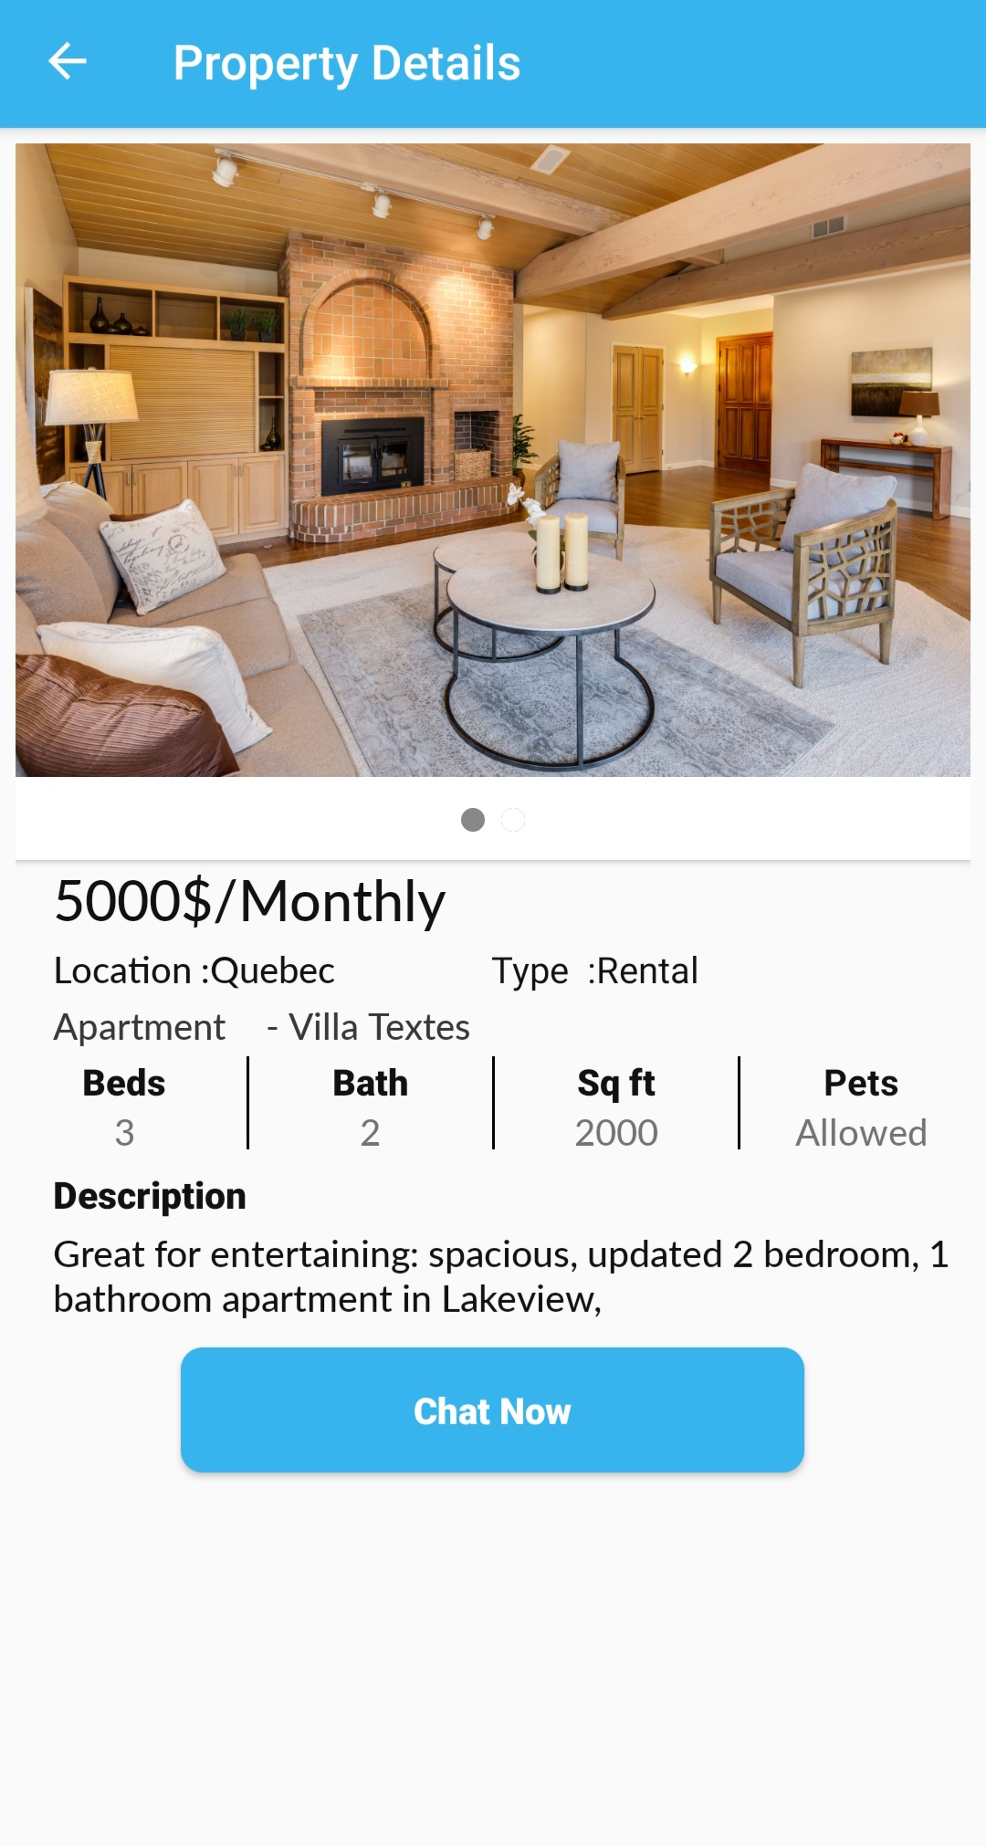
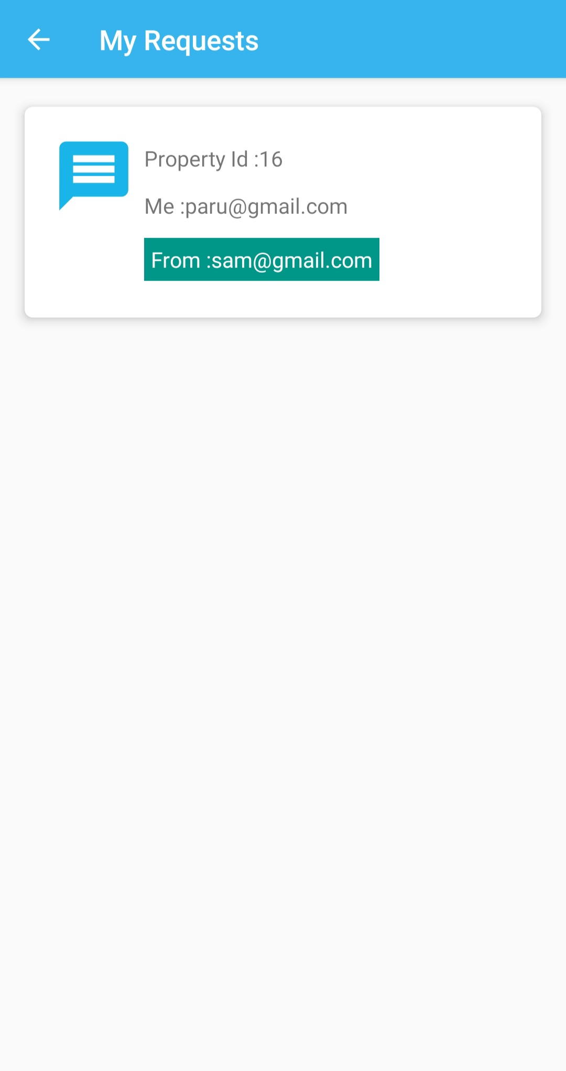
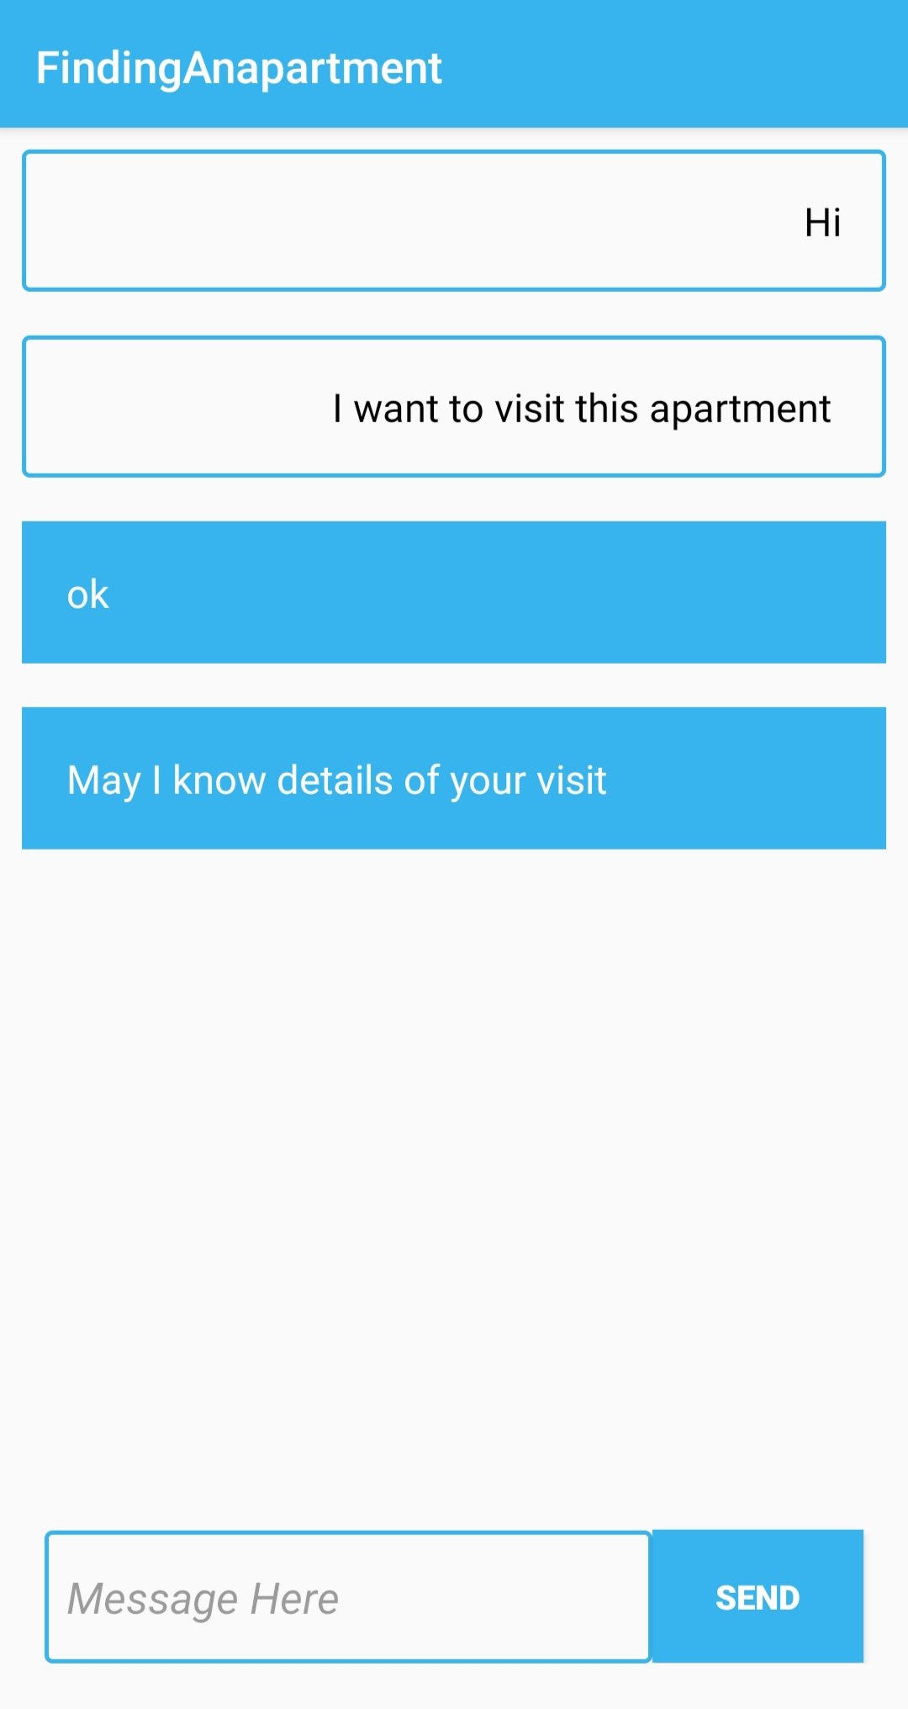

Slide 24
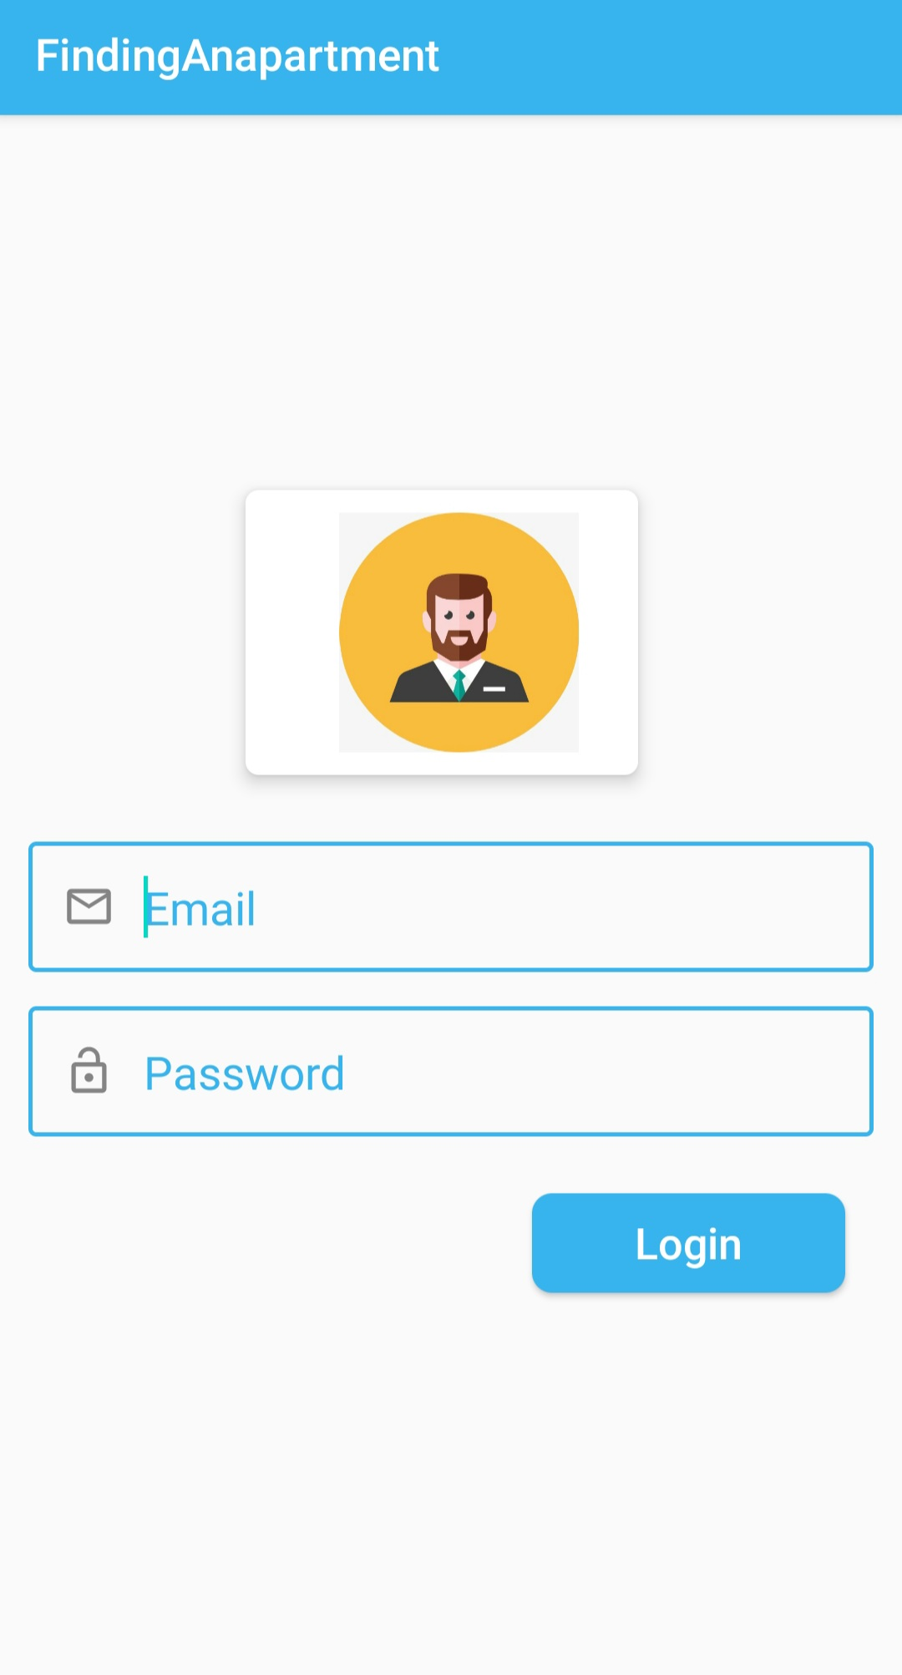
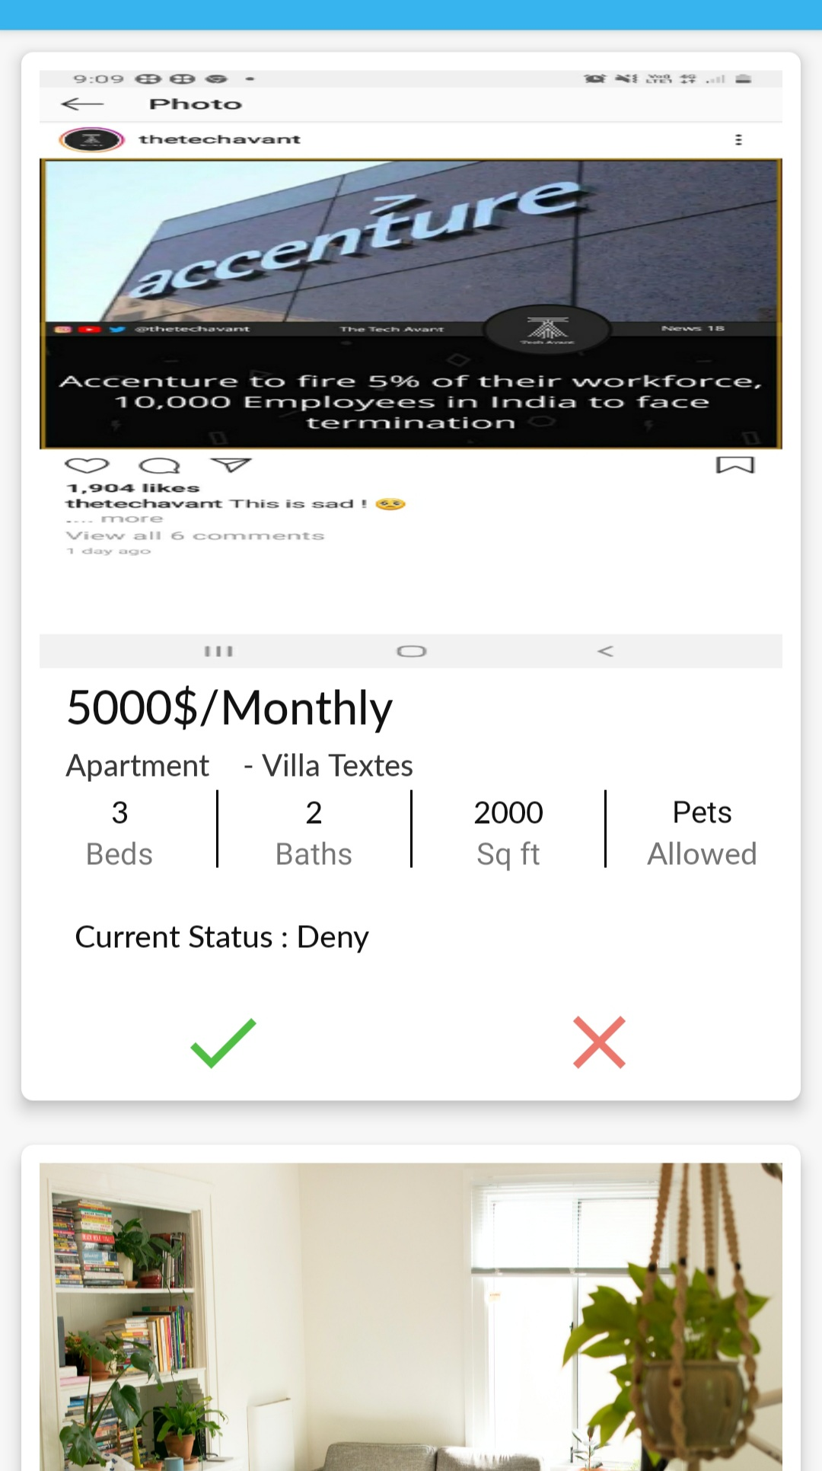
Admin:
Admin home

Slide 25
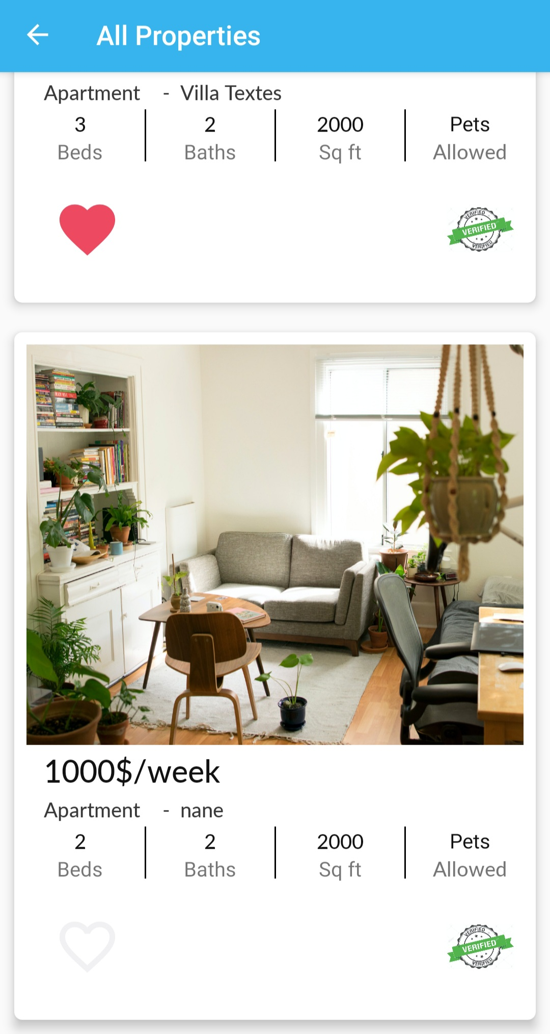
Guest User:

Slide 26
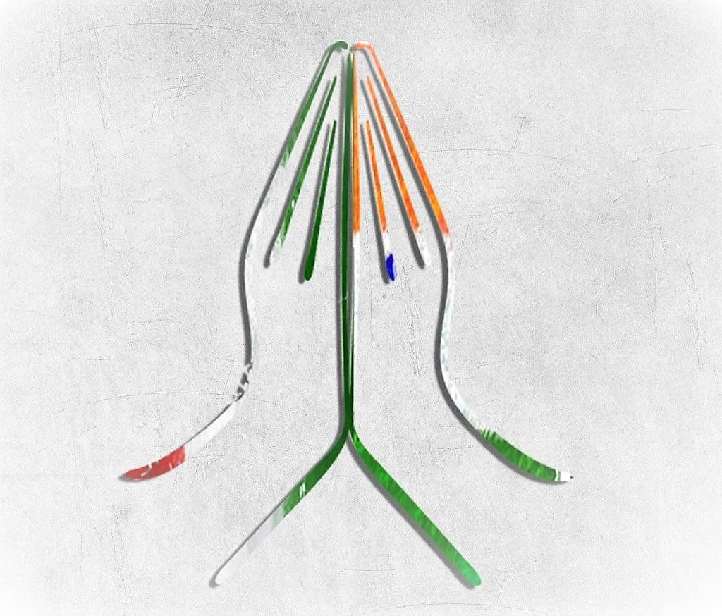
Thank You

